Slide 1
SECRETS OF INTERNET

Slide 2
“ I PREDICT THE INTERNET WILL SOON GO SPECTACULARLY SUPERNOVA ”
-ROBERT METCALFE (1995)
Traced back to 1958
Mid-to-late 1990’s, booming

Slide 3
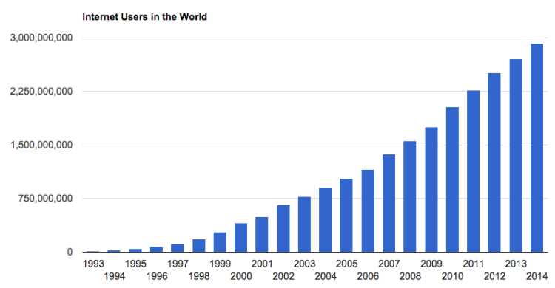

Slide 4

Was not designed for Anonymity/Privacy.
Concerned issue for people.

Slide 5
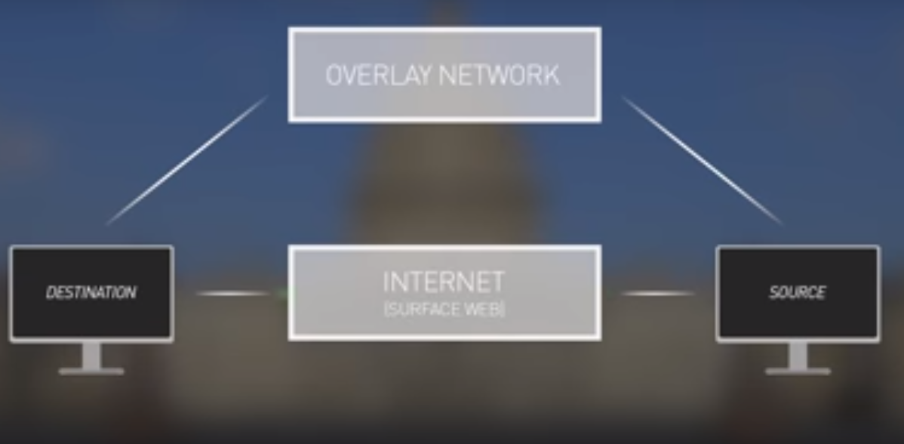
Naval Research Lab (NRL)
Created Overlay network - Onion Routing
TOR – Anonymous Bi-directional communication

Slide 6
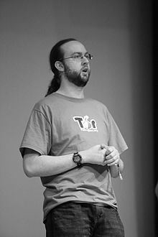

Why released to Public ?
Released as open source -2004
ROGER DINGLEDINE
(Founder of TOR)
-(audio)

Slide 7
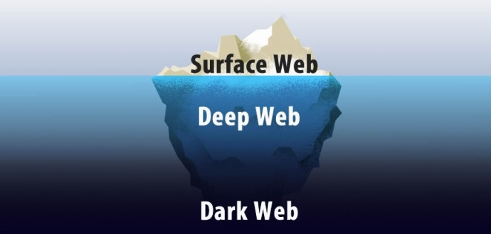
Surface web – indexed by search engines
Deep web – not indexed by search engines
eg: pay-wall/password protected sites Netflix, NetBanking

Slide 8
Dark Web
Fraction of deep web
Consisting of numerous Darknets
Require specific authorisation/SW to access
Contain Hidden services

Slide 9
Hidden Services
Online drug marketplace
Oct 2013 FBI took down Silk road
Months later Silk road 2.0 ..... 3.0
Hitmen – online contract murders
Sexualised torture
Animal killing
Child pornography – Lolita City , Play Pen
Red rooms – Live streaming of murder for entertainment

Slide 10
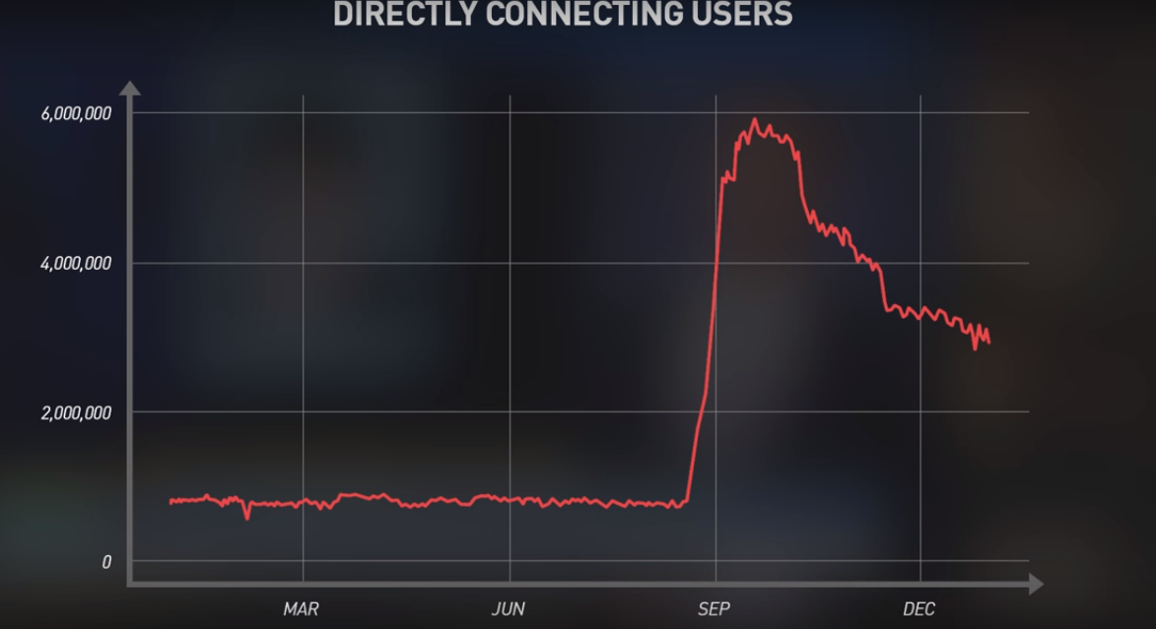

Slide 11
CONCLUSION

